Slide 1
I/O Device Virtualization in the x86 Architecture
Dr. Amit Praseed

Slide 2
I/O Device Virtualization
Allows multiple logical devices to be implemented by a smaller number of physical devices
Provides for flexible mappings between logical and physical devices, facilitating seamless portability
Device aggregation
Multiple physical devices can be combined into a single more capable logical device
New features can be added to existing systems by interposing and transforming virtual I/O requests, transparently enhancing unmodified software with new capabilities
Enhanced system security

Slide 3
Challenges
Defining appropriate semantics for virtual devices and interfaces, especially when faced with complex physical I/O devices or system-level optimizations
Device contention between multiple VMs
Achieving good I/O performance despite the potential overhead

Slide 4
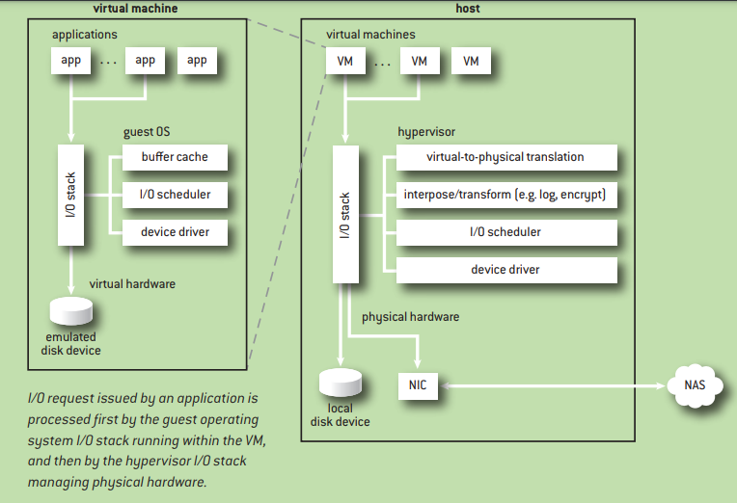

Slide 5
Split Driver Architecture
Most hypervisors employ a split driver architecture for dealing with I/O devices
different virtual device interface emulation front-ends
multiple different back-end implementations of the device
The virtualization layer and the virtual-device emulation code must support the architectural and device semantics

Slide 6
Need for Optimization
Reducing I/O-virtualization overhead requires decreasing virtual-device emulation costs
reduce the number of trap-and-emulate operations
using virtual hardware optimized for the virtualization layer - paravirtualization
Pass through mode – when a single VM uses a device

